Slide 1
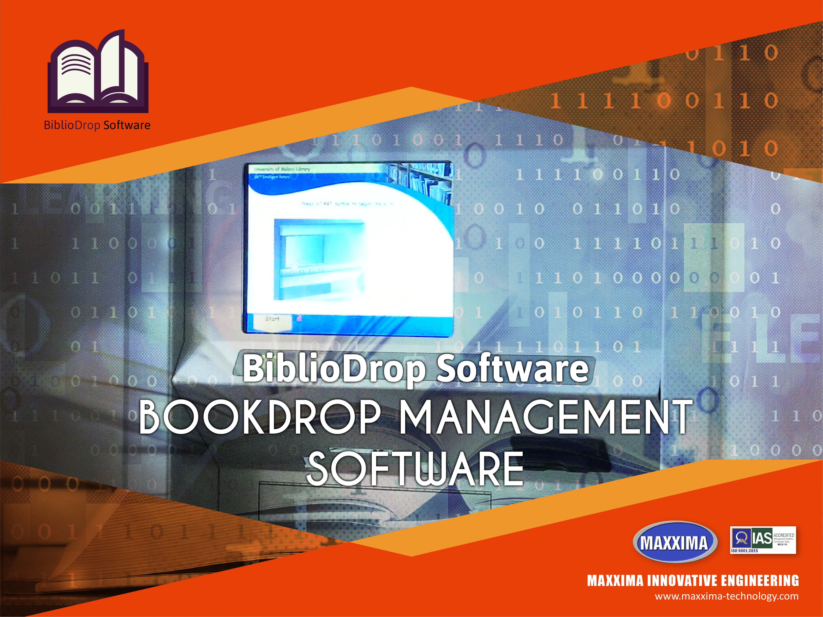


Slide 2







Overview
Dashbaord & Reporting
Login by RFID Card
Login By Username & Pass
User Information Details
Return History
Print
Integration
Database & Apps Library Management System

Slide 3
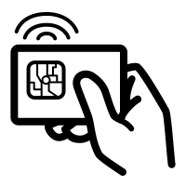
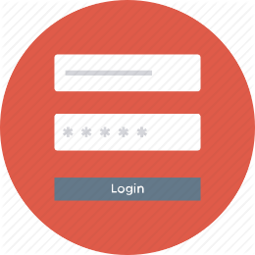

Access Login By RFID Card
Login using an RFID Card, the system can be configured to read library membership cards that use an RFID card
Access Login By Username Password
If the user does not bring a user card, it is still possible to return the book by logging in using the username & password
User Information Details
After the user has successfully logged in and entered the system, the user can view detailed user information on the application

Slide 4



Return History
Viewing the history of returning your collection in this menu, the application can display data related to library collections that have been returned
Print Out
Print the proof of returning your collection, save the proof so it can be used at any time if needed
Integration
Integrate applications with the Library Management System using web service methods (JSON, XML).

Slide 5

New Book Collections
Displays information about the latest collections in the library and if you want detailed information, just click on the information

Slide 6



